Slide 1




Auditor training programme: Unit 1
These slides are intended as a resource for facilitators delivering the ESSA Auditor Training Programme to student auditors.
Disclaimer
This resource was produced as part of the European Students’ Sustainability Auditing project which received funding from Erasmus+ during 01.09.2016 – 31.08.2019 (Contract number: 2016-1-UK01-KA203-024648)
The sole responsibility for the content of this resource lies with the authors. It does not necessarily reflect the opinion of the European Union. The European Commission are not responsible for any use that may be made of the information contained therein.
This work is licensed under a Creative Commons Attribution-NonCommercial-ShareAlike 4.0 International License.

Slide 2
UNIT 1. Introduction to the project and University Social Responsibility

Slide 3

Welcome, introductions and check-in

Slide 4
Schedule
9 am: | Welcome and introductions. Check-in
10 am: | Introduction to the training and the project
11 am: | University Social Responsibility (USR)
12 pm: | Lunch
1 pm: | Your role as a student auditor
3 pm: | Videos of best practices and discussion Check-out
5 pm: | End of training

Slide 5

Introductions…
Tell us your…
  Name?
  Degree?
  Where you are from?
  Hobbies?
  Interest in social responsibility and sustainability?
Notes:
Ask students to write this down on a post-it note and then ask them to share with the wider group. This includes the facilitators. On a separate post it note ask students to contribute an idea/principle to the ground rules.

Slide 6
Ground rules
We respect each other
We try our best
We are a team
We learn from mistakes
We create
We celebrate each other‘s success
Notes:
Go through the suggestions and the above image – highlight that people can add to these and we will be asking for feedback at the end of the day.

Slide 7

Check-in
What are your expectations for the programme?
Write down your expectations for this day on the Post-it note and stick the note to the wall.
We will come back to your expectations at the end of the day.
Notes:
Expectations for the whole programme and role – including issues/concerns/learning outcomes.

Slide 8
Introduction to the training and the project

Slide 9
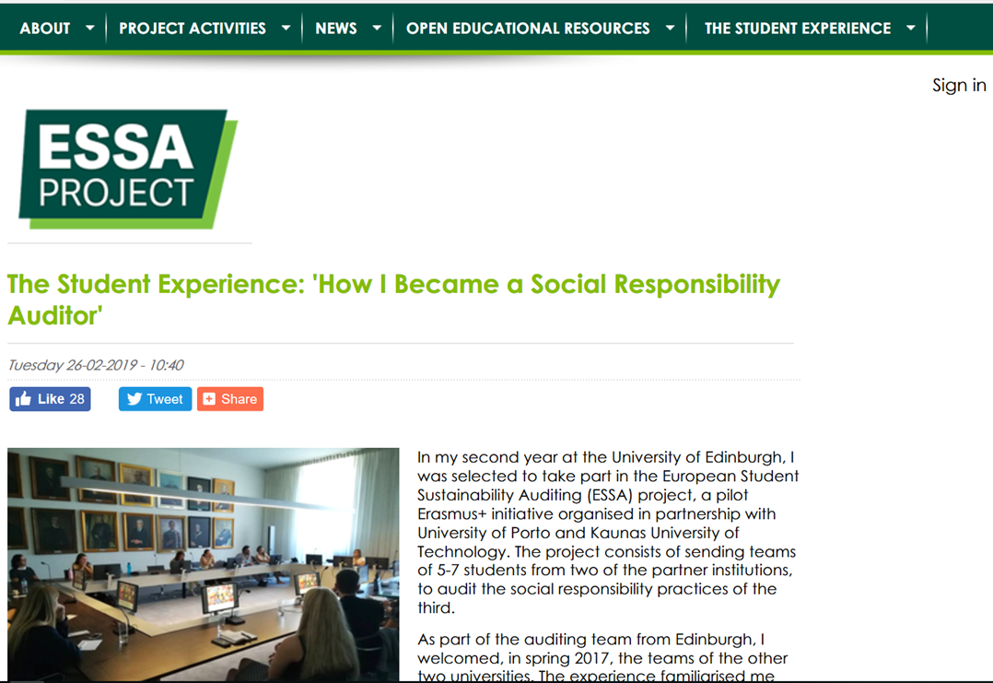
Welcome to ESSA Project
www.essaproject.eu

Slide 10

Like the ESSA page on Facebook ☺

Slide 11
Auditor training programme
Unit 1 | Unit 2 | Unit 3 | Unit 4 | Unit 5 | Unit 6
The project ESSA Main concepts USR | USR Audit and auditing Auditor skills Team Building | USR Bench-marking criteria | Methods of auditing | Simula-tion of USR audit | Report writing

Slide 12
After today‘s training, you will...
Be confident of your role and responsibilities
Have knowledge and awareness of ESSA project
Gain understanding of your role as auditor
Acquire knowledge of USR by reviewing current practice

Slide 13
After the completion of the training programme, you will...
Have knowledge about social responsibility auditing
Be able to identify the resources required for a social responsibility audit
Be able to perform an audit of USR in a selected university
Be able to conduct interviews & focus groups;
Be able to analyse data/ evidence
Have skills of writing and presenting a report as a feedback; be able to self-reflect.

Slide 14
ESSA aims to:
Better understand how social responsibility and sustainability are embedded across institutions
Allow students to engage with real world issues
Develop a flexible approach to student learning, assessment and certification
Effectively integrate practical training and learning in and from real-world situations.

Slide 15
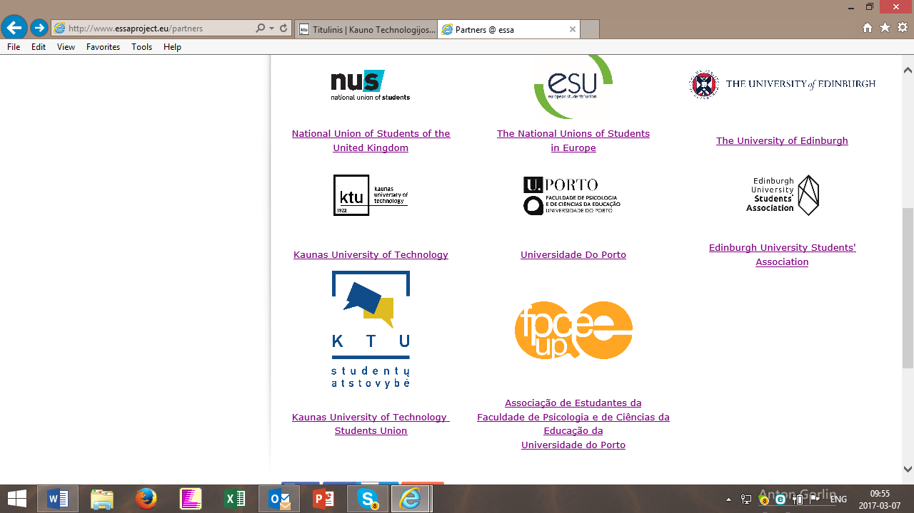
Project partners
Notes:
A slide with the map of Europe would be nice. People are very visual ☺

Slide 16
What were the main project activities?
  The Project duration ran from September 2016 to August 2019
  60 students from the participating universities trained as auditors
  Participating students received ECTS 5 Credit Certificate in Social Responsibility Auditing (EQF Level 6).
  Four pilot cross national audits undertaken (fully funded travel and accommodation for students)
  Events hosted by partner Universities and ESU in 2019 disseminated the learning outcomes and outputs of the project across the EHEA

Slide 17
Five main stages of the ESSA Project
Student Auditor Training
University Audits
Student Assessment and Certification
Feedback to Universities
Facilitator Training

Slide 18
Innovative approach to assessment and certification
Promoting experiential learning
Student-Led Individually Created Course (SLICC) development
Reflective framework for students to develop their own set of personal and professional skills and attributes through this experience

Slide 19
Open Educational Resources developed by ESSA
Open Educational Resources (OER) have been produced to enable other universities to deliver the project:
  Facilitator Training Programme
  Student Auditor Training Programme
  Audit Manual for use by the trained student auditors of the USR
  Framework for the assessment of the learning outcomes
  Range of case studies of good practice

Slide 20
ESSA’s positive impact on student learning
  Focus on experiential learning
  Developing key graduate attributes and employability skills
  Attaining a 5 ECTS Certificate in Social Responsibility Auditing
  Understanding of how social responsibility is implemented in universities
  Social mobility opportunities

Slide 21
The project’s positive impact on the university sector
Sharing interesting practice and promoting knowledge exchange:
  Identifying case studies of good practice from audits and sector-wide
  Dissemination to external audience
    Public website and social media channels
    End of project multiplier events
    Academic papers and events

Slide 22
How will you be assessed?
You will be awarded a Level 6 EQF Certificate in Social Responsibility Auditing following satisfactory completion of:
the training
the linked audit
the assessment requirements by means of production of individual e-portfolio of evidence of learning

Slide 23
Student Auditor Training Programme
Will provide you with the necessary skills and knowledge enabling you to support and undertake a social responsibility audit
Will contribute towards your, as a student auditor, positive experience
Will help you learn and experience experiential learning

Slide 24

You are becoming auditors of University Social Responsibility

Slide 25
What are the key tasks for you?
Complete student auditor training
Audit:
  Review documentary evidence
  Interview key stakeholders
  Facilitate focus groups
  Provide observations and recommendations
  Contribute to audit report for institution
Self-reflective learning for the course & monitoring and evaluation activities

Slide 26

Questions?

Slide 27
University Social Responsibility (USR)

Slide 28

What is USR? General concepts
Video: University Social Responsibility
Notes:
https://www.youtube.com/watch?v=AFJ98Yk1RWo

Slide 29
USR is about making a difference
University Social Responsibility (USR) promotes responsible everyday management, referring to:
  Research, Teaching, Support for Learning and Public Engagement
  Governance
  Environmental and Societal Sustainability
  Fair Practices
USR Benchmark Standards developed in 2015.

Slide 30
USR Benchmark Standards frame the ESSA Project
Created as a strategic response to the:
  - Need to develop a Common European Reference Framework for all European universities
  - Common strategy to enhance social responsibility of universities in a long term perspective
Supported by the EU Lifelong Learning Programme
Three year project which involved multiple European partners, completed in 2015.

Slide 31

Example: USR at the University of Manchester
Video: Social Responsibility at The University of Manchester
Notes:
https://www.youtube.com/watch?v=JfH9W3TzfiI

Slide 32

An example of recycling practices
Video: Responsible cartridge recycling
Notes:
https://www.youtube.com/watch?v=ljLisjRLedM

Slide 33
After watching:
Reflect on the videos
How would you explain the link between:
Sustainability – Social Responsibility
What do you think are the three key words of USR Benchmarking?

Slide 34

Check-out
On Post-it notes:
Write the main concepts you have learned about social responsibility.
Reflect on expectations.
Write down your assumptions related to USR.
Any other questions?

