Slide 1




Auditor training programme: Unit 4
These slides are intended as a resource for facilitators delivering the ESSA Auditor Training Programme to student auditors.
Disclaimer
This resource was produced as part of the European Students’ Sustainability Auditing project which received funding from Erasmus+ during 01.09.2016 – 31.08.2019 (Contract number: 2016-1-UK01-KA203-024648)
The sole responsibility for the content of this resource lies with the authors. It does not necessarily reflect the opinion of the European Union. The European Commission are not responsible for any use that may be made of the information contained therein.
This work is licensed under a Creative Commons Attribution-NonCommercial-ShareAlike 4.0 International License.

Slide 2
UNIT 4. Methods in auditing and audits

Slide 3

Welcome and recap

Slide 4
Feedback from the previous unit
What did you take away from the previous day of training?
How would you explain USR Benchmarking criteria?
Any outstanding or new questions?

Slide 5

Check-in – draw your mood!

Slide 6
Schedule
9am: | Welcome and recap
10am: | Quantitative and qualitative approaches to auditing, sources of evidence
10.30am: | Main research methods in auditing
11.30am: | Creating instruments for USR auditing
1pm: | University campus observation + grab your lunch
2.30pm: | Discussion and analysis of the University campus observation
4pm: | Organising USR audit: methods, results and ethics Check-out
5pm: | End of training

Slide 7
After today‘s training, you will...
Have an understanding of the main methods and tools used in auditing
Be able to apply different research methods tools and instruments to benchmarks and audits to come
Be able to organise the research process and to how to deal with the problems in auditing.

Slide 8
Quantitative and qualitative approaches to auditing

Slide 9
Research approaches: qualitative and quantitative
Quantitative
Qualitative

Slide 10
Quantitative research methods
Requires quantifiable data involving numerical and statistical explanations
Is used to quantify the problem by way of generating numerical data or data that can be transformed into usable statistics
Is used to quantify attitudes, opinions, behaviours, and other defined variables – and generalise results from a larger sample population
Uses measurable data to formulate facts and uncover patterns in research
Data collection, face-to-face interviews, telephone interviews, longitudinal studies, website interceptors, online polls, and systematic observations

Slide 11
Qualitative research methods
Involves describing in detail a specific situation using research tools like interviews, surveys, and observations
Is primarily exploratory research
Is used to gain an understanding of underlying reasons, opinions, and motivations
Provides insights into the problem or helps to develop ideas or hypotheses
Is used to uncover trends in thought and opinions, and dives deeper into the problem
Data collection methods vary using unstructured or semi-structured techniques include focus groups (group discussions), individual interviews, and participation/observations
Sample size is typically small

Slide 12

Gathering experience and learning expectations
What kind of methods you have heard of and what you already know?
How confident/comfortable do you feel?
What do you need to enhance your confidence/make you feel comfortable?

Slide 13
Main research methods in auditing

Slide 14
The main research methods in auditing
Document analysis
Questionnaires
Interviews
Focus groups
Site observation

Slide 15
Document analysis
There are three primary types of documents (O’Leary, 2014):
Public Records: The official, ongoing records of an organisation’s activities. Examples include student transcripts, mission statements, annual reports, policy manuals, student handbooks, strategic plans, and syllabi.
Personal Documents: First-person accounts of an individual’s actions, experiences, and beliefs. Examples include calendars, e-mails, blogs, Facebook posts, duty logs, incident reports, reflections/journals, and newspapers.
Physical Evidence: Physical objects found within the study setting (often called artifacts). Examples include flyers, posters, agendas, handbooks, and training materials.
“How to Analyze a Document”
https://www.youtube.com/watch?v=kSWvAmnlho8
Notes:
Trainer presents main types of documents and shows the video “How to analyze a document”.
Presented types are illustrated and discussed in group by imagining what kind of documents it could be in university case.

Slide 16

Questionnaires
There are the following types of questionnaires:
Computer questionnaire
Telephone questionnaire
In house survey
Mail Questionnaire
Questionnaires may include the following types of questions:
Open question questionnaires
Multiple choice questions
Dichotomous questions
Scaling questions
Video on questionnaires:
https://www.youtube.com/watch?v=7onVHIkS1YY
Notes:
Short presentation on types of questionnaires. Trainer shows the video and asks the group for the short feedback.

Slide 17

Interviews
There are three different formats of interviews:
structured
semi-structured
unstructured
Video: “25 Common face-to-face interviews and questions”

Slide 18
Focus groups
A group discussion conducted with the participation of 7 to 12 people to capture their experiences and views regarding specific issues closely related to the research question
Data collection methods is most suitable for types of studies where multiple perspectives needed to be obtained regarding the same problem
Is led by a moderator whose responsibility is to ensure that group discussions remain focused on research area
Advantages of focus groups include possibility of obtaining primary data through non-verbal channels, as well as, verbal channels and approaching the research area from various perspectives
Notes:
Trainer presents the main characteristics of focus group method.

Slide 19
Focus groups
How do you prepare for a focus group discussion?
Video: Conducting a focus group
Notes:
https://www.youtube.com/watch?v=Auf9pkuCc8k
https://www.youtube.com/watch?v=cCAPz14yjd4

Slide 20
Site observation
Is a way of collecting data through observing
May be structured or unstructured
Structured or systematic observation data collection is conducted using specific variables and according to a pre-defined schedule
Unstructured observation is conducted in an open and free manner in a sense that there would be no pre-determined variables or objectives
Advantages of observation primary data collection method include direct access to research phenomena, high levels of flexibility in terms of application and generating a permanent record of phenomena to be referred to later if a need arises
Notes:
Trainer presents the framework of the site observation process.

Slide 21
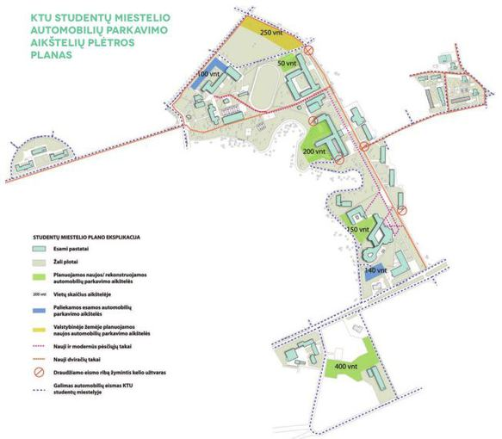
Site observation
Method is disadvantaged with longer time requirements, high levels of observer bias, and impact of observer on primary data, in a way that presence of observer may influence the behaviour of sample group elements
Data collection method may be associated with certain ethical issues
Video: Observation method
Notes:
https://www.youtube.com/watch?v=ZP6YzRR0lSk

Slide 22
Creating instruments for USR auditing

Slide 23
Pair work
Creating instruments for USR auditing.
Work in pairs on the 5 main research methods:
document analysis
questionnaires
interviews
focus groups
site observation.
Each pair chooses 1-2 research methods and 1 benchmark to work on.
Make sure that all methods and benchmarks are covered.
Notes:
The group is divided into small groups of 2-3. Each small group/pair choose 1-2 research methods (depends on the number of participants) and one of 4 benchmarks.

Slide 24
Creating auditing instruments
Peer-review
Top tips discussion: what are the main problems and difficulties?
Notes:
Working groups exchange the research instruments they have created. Groups analyse their peers’ work and take turns to give feedback (tips and tops): what they like, what they don’t understand, and to explain their choices and decisions.
The trainer moderates the discussion.

Slide 25
University campus observation and lunch

Slide 26

Exercise: let’s observe the campus
Don’t forget to grab your lunch!
Notes:
Students explore the university campus while having “a walking lunch” . The task is to walk around without any special goals. After lunch students give their feedback on what they have noticed while walking around and observing: buildings, staff, symbols, environment and so on.

Slide 27
Discussion and analysis of observation

Slide 28
Discussion and analysis
Welcome back!
Your feedback after the University campus observation…

Slide 29
Role play: Interviews and focus groups

Slide 30

Role play: Interviews and focus groups
Use the questions prepared for interviews and focus groups to have role-plays

Slide 31
Organising USR audit - research methods, results and ethics

Slide 32
Discussion: organising USR audit: research methods, results and ethics
How to plan the auditing process?
How to analyse and understand the results?
Ethics - what should we think about before the audit?
Notes:
The trainer moderates the discussion on the following questions:
How to plan the auditing process?
How to analyse and understand the results?
The trainer explains how and why research ethics is important during the auditing process.

Slide 33
Research ethics principles
Voluntary participation
Informed consent
Respect to individual’s dignity
Anonymity
(Howe and Moses, 1999)
Notes:
The trainer presents and explains the main principles of research ethics and responsibilities of researcher.
Moderates group discussion and asks students to give examples.

Slide 34
Check-out

Slide 35

Check-out
Notes:
Students share what they have learned during the day. Trainers answer the questions and help to find out solutions unclear situations students have experienced.

